Slide 1
2023 NATIONAL YOUTH RISK BEHAVIOR SURVEY Co-Occurring Adverse Experiences & Protective Factors in Adolescent Suicidality
A survey-weighted analysis of self-reported adversity, protective behaviours, and suicide-risk outcomes among U.S. high school students
Jacinta · Aliya · Destiny · Albert · Terence · Francis · Bernard

Slide 2
Table of contents
01
Background
An introduction to our project, key aims and objectives
04
Limitations
A closer look at our dataset refinements and further analysis
02
Methodology
An overview of our approach to the data source, and methods of collaborative working (GitHub, Teams, Google Drive)
05
Conclusion
A summary of our future direction and next research question
03
Key findings
A breakdown of key results across the four suicide outcomes

Slide 3
01
Introduction
An introduction to our project, key aims and objectives

Slide 4
Background
2021
2022
2023
2026
Emergency
Hearing
Evidence
Investigation
American Academy of
Child and Adolescent
Psychiatry declared a
"national emergency in
child and adolescent mental health" in the U.S.
The U.S. Senate HELP Committee held a
formal hearing,
“Why Are So Many American Youth in a Mental Health Crisis?"
CDC’s national survey quantifies the scale of the crisis among U.S. high schoolers
Our project examines which adverse and protective experiences
co-occur with this risk

Slide 5
Background
Suicide is the second leading cause of death among Americans aged 10-34
Over the past decade, rates of serious suicidal ideation have rise

Slide 6
Background
1 in 5
39.7%
9.5%
seriously considered attempting suicide in the past 12 months
of students reported persistent sadness or hopelessness
in the past 12 months
attempted suicide one or more times
in the past 12 months

Slide 7
Learning More
Suicide risk rarely comes from one thing. This gap motivates our research question:
how do adverse and protective experiences co-occur with adolescent suicidality, and what does that mean for where prevention efforts should focus?

Slide 8
02
Methodology
Finding Co-occurance between adverse experiences and protective factors.
Compare our independent analysis with current research

Slide 9
Study design: 2023 National YRBS
What is it?
Why does this design matter?
A nationally representative, biennial CDC survey of U.S. high school students (grades 9-12)
Anonymous, self-report questionnaire: every value in this dataset is what a student said, not something independently verified
20,103 usable student responses in the 2023 cycle measuring over 100 different variables.
Three-stage stratified cluster design:
strata → primary sampling units (PSUs, roughly clusters of schools) → classrooms
Weight
Each respondent stands in for a number of real students nationally (not every student in the survey represents just one person)
stratum / psu
Students in the same school answer more alike than random students elsewhere.
Ignoring this understates uncertainty.

Slide 10
Our Selected Variables
 | Domain | Details | Variables
Jacinta | Demographics | Age, Ethnicity etc | Q1, Q2, Q3, raceeth
Aliya | Protective factors | Grades, Sleep, Basic Needs Met, Social life | QN85, QN87, QN99, QN103, QN104
Destiny | Adverse factors | Sexual dating and violence | QN19, QN20, QN21, QN88
Albert | Adverse factors | School and community | QN22, QN23, QN24, QN25, QN86
Terence | Adverse factors | Household dysfunction | QN89, QN90, QN91, QN100, QN101, QN102
Francis | Risk behaviours | Violence and mental distress | QN12, QN13, QN16, QN26, QN84
Bernard | Risk behaviours | Substance use | QN43, QN48, qntb4, qnillict, qnowt, qnobese
Variable Research, with cited Publications for the inclusion on each factor

Slide 11
Outcome Variables
Variable Occurence
"QN27", # seriously considered suicide (12mo)
"QN28", # made a suicide plan (12mo)
"QN29", # attempted suicide 1+ times (12mo)
"QN30" # attempt resulted in injury p-values, why not? 118 out of 124 were significant; as such, the p-values showed limited ability to distinguish important from negligible associations.
both
Outcome Variable Occurred

Slide 12
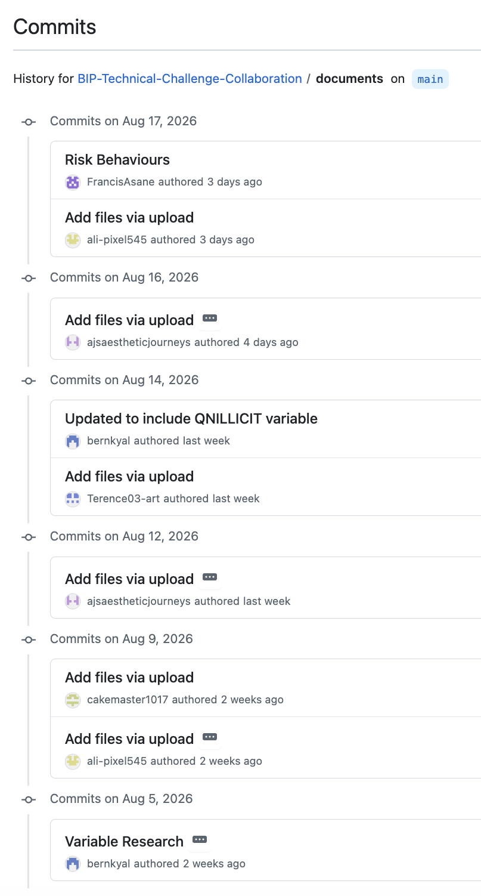
Reproducibility via GitHub
Everything lives in one place
All scripts, data, documentation, and outputs are tracked in a single public repository to see the full history of the project
Every change is logged and attributed
21 commits across the project, each with a description of what changed and who changed it (from variable selection to charts)
Structured for reproducibility
Separate folders for data, scripts, output, markdown, and documents. The pipeline from raw data to final figures is traceable end-to-end.
Analysis can be re-run from scratch
Anyone can rebuild our results because the R scripts and outputs are version-controlled together

Slide 13
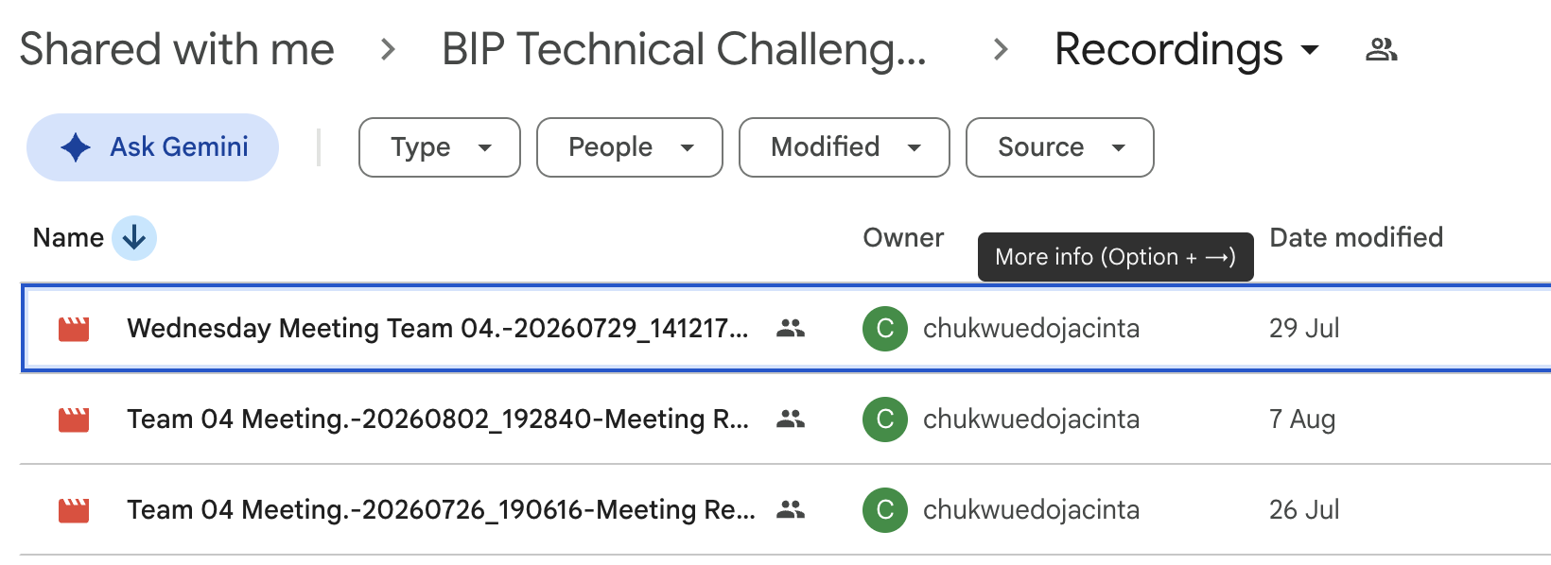
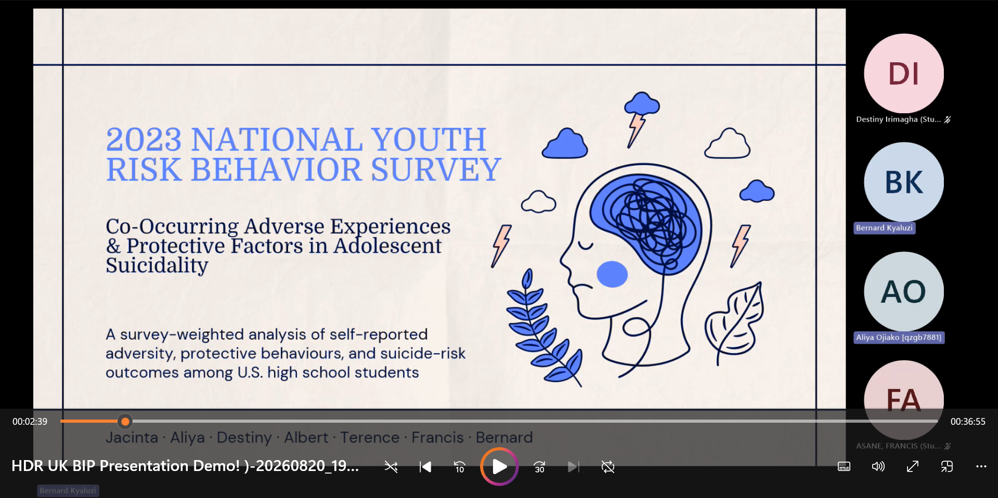
Collaboration via Google Drive & Teams

Slide 14
03
Key findings
A breakdown of key results across the four suicide outcomes

Slide 15
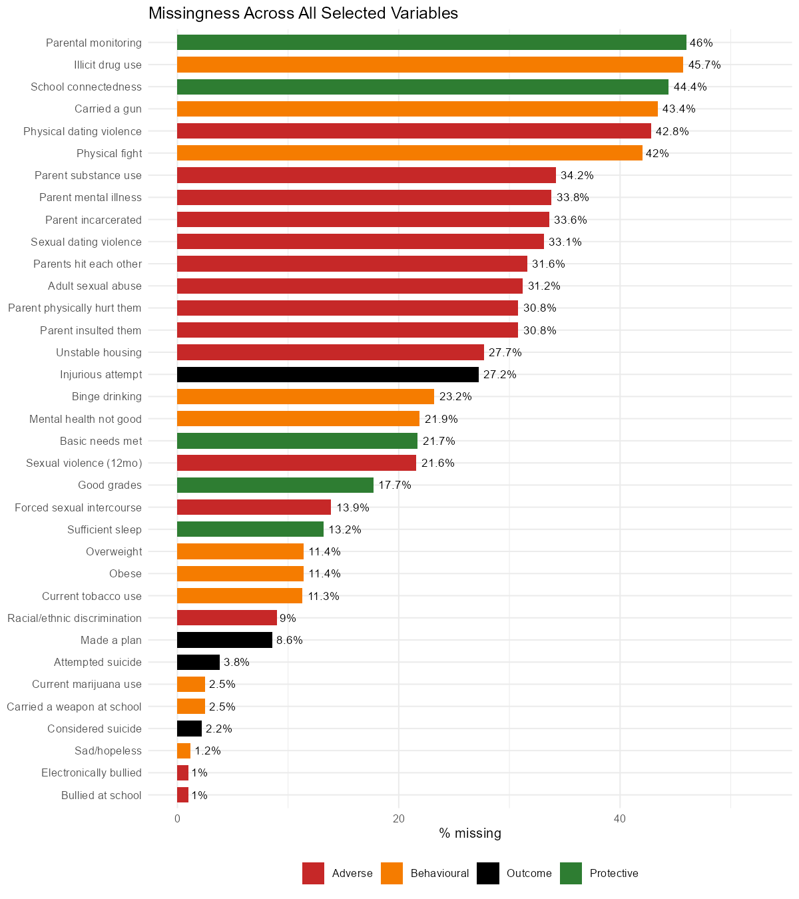
Variables Missingness Audit
Missingness ranges from 1.0% to 46.0%, with the highest-missingness variables found in the household-adversity, connectedness, and monitoring cluster
CDC's minimum-cell-size convention (unweighted N >= 30 per reported group) was applied throughout the analysis

Slide 16
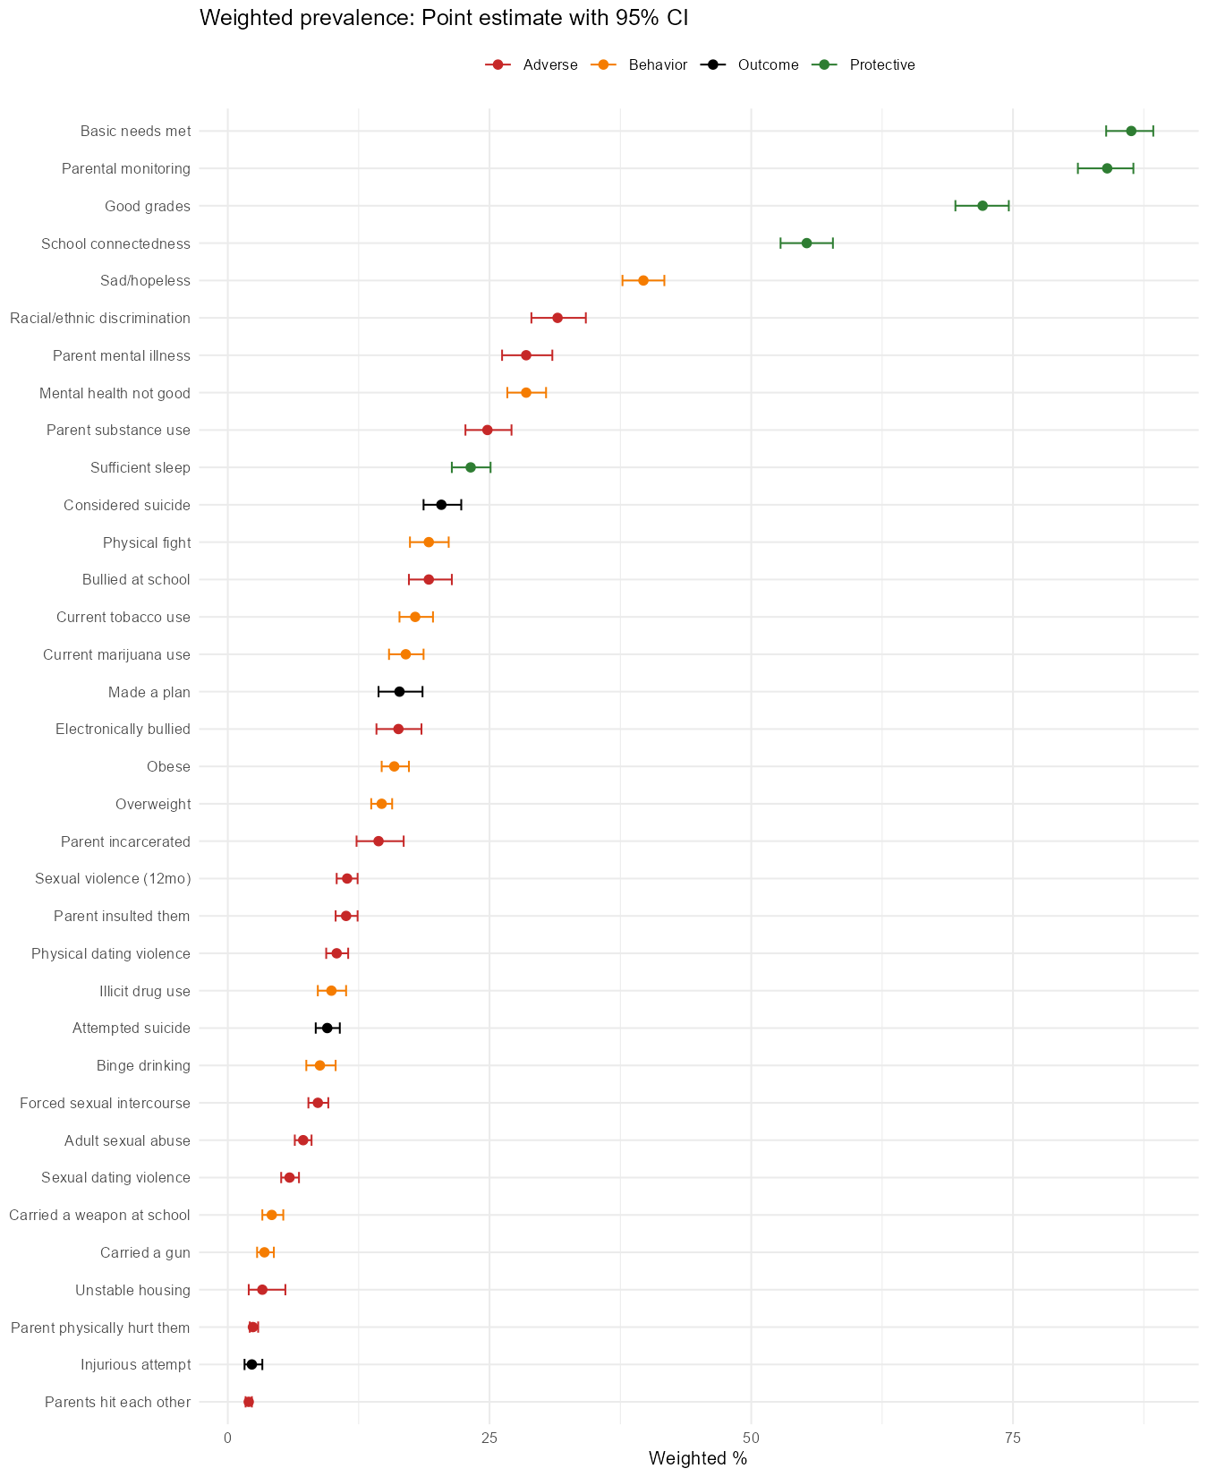
Weighted Prevalence of Variables
Weighted prevalence across the variables ranges from 2.0% (parents hit each other) to 86.3% (basic needs met)
Four of the five Protective factors exceed 50%: Protective factors are the norm in this population, not the exception
These estimates describe how common a given experience or behaviour is in the population

Slide 17
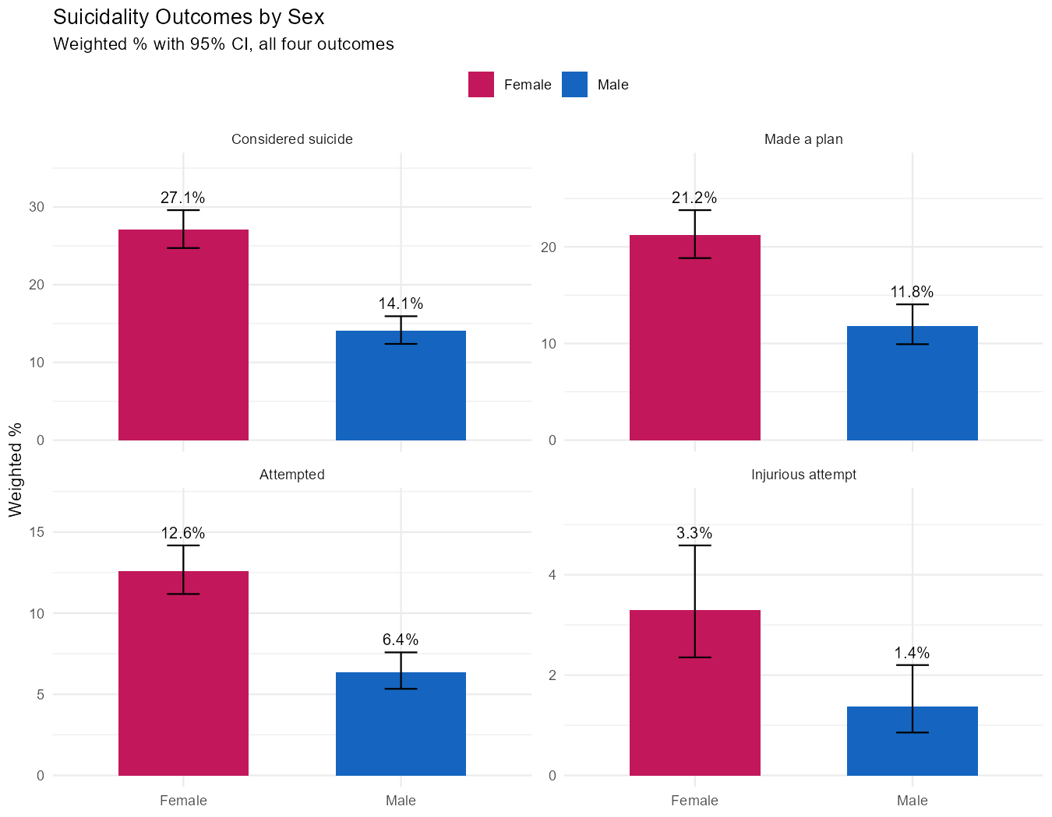
Demographics (Jacinta’s Variables)
Outcomes Prevalence by Sex
Sex shows the strongest and most consistent demographic pattern in this dataset
Female students report 2x the prevalence of male students across all four outcomes
Respondents Racial Composition
White 48.1%
Multi-Hispanic/Latino 19.8%
Black 13.3%
Hispanic 7.7%
Multi-non-Hispanic
6.1%
Asian 4.3%

Slide 18
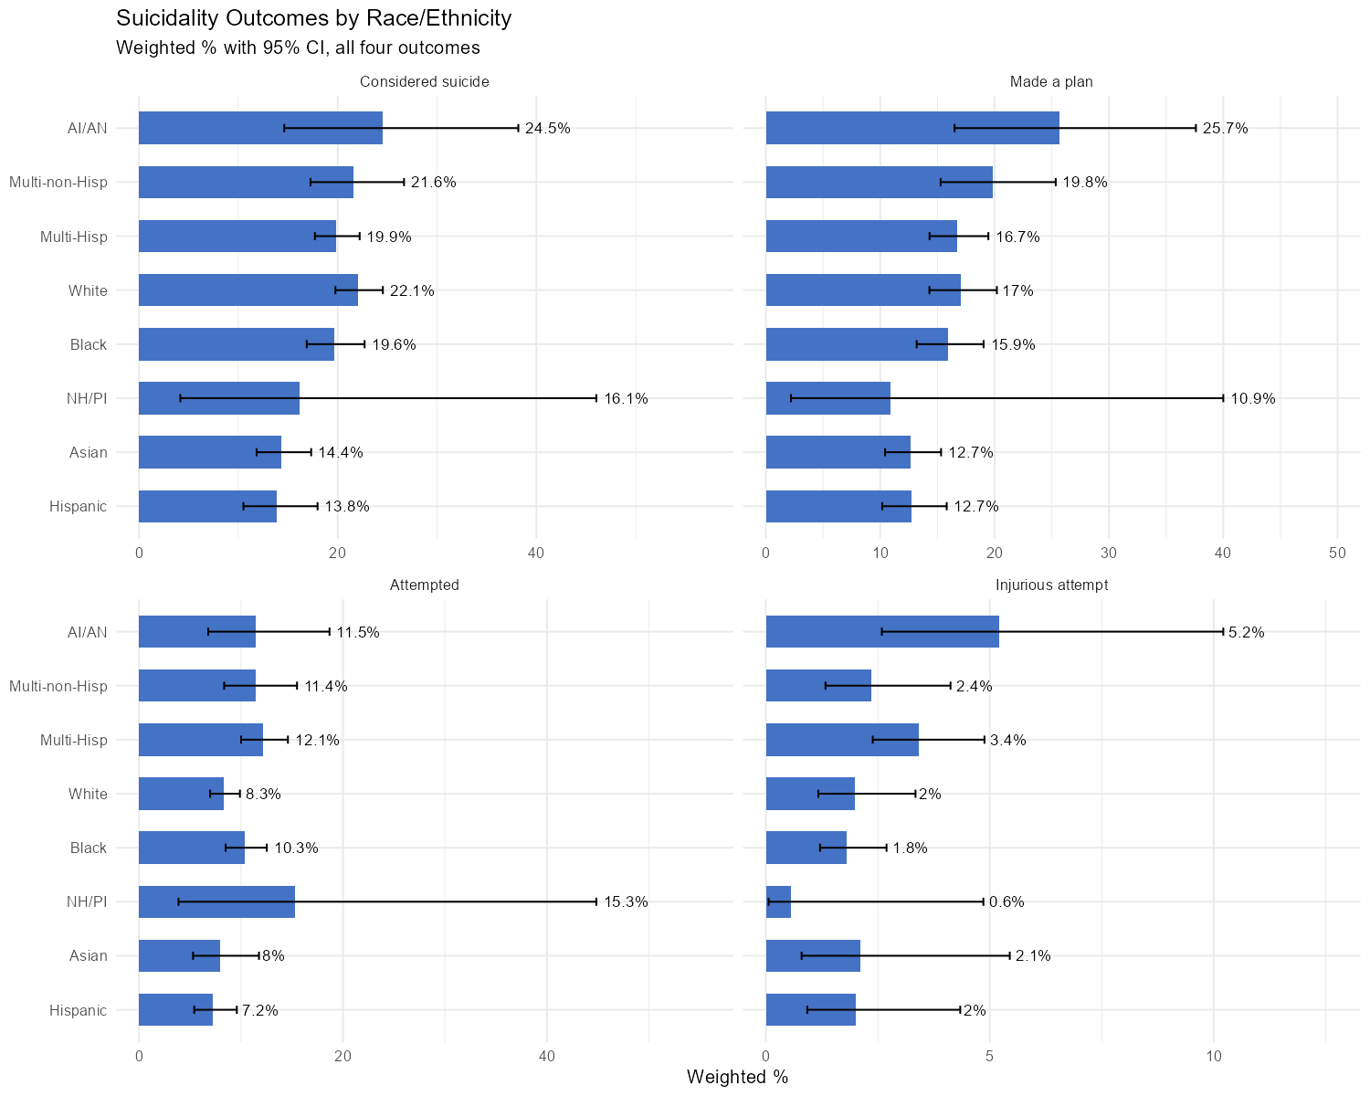
Outcomes Prevalence by Race/Ethnicity
Race/ethnicity is statistically significant for considered suicide and attempted suicide (p<0.05), but not significant for made a plan or injurious attempt (p>0.05)
AI/AN students generally had the highest or near-highest prevalence. Wider confidence intervals for AI/AN and NH/PI groups reflect smaller subgroup sample sizes

Slide 19
Aliya’s variables (Protective Factors)
HOLDS ACROSS
ALL OUTCOMES
All 5 protective factors showed lower prevalence on every one of the 4 suicidality outcomes:
Considered
Planned
Attempted
Injured

Slide 20
Protective Factors Validated By CDC’s Findings
Factor | CDC adjusted PR (2023 YRBS) | Our ratio (unadjusted) | Agreement
Sleep (QN85) | 0.53 - 0.67 | 0.48 - 0.49 | Close match
Basic needs met (QN99) | 0.41 - 0.80 | 0.23 - 0.66 | Close match
Parental monitoring (QN104) | 0.51 - 0.74 | 0.34 - 0.66 | Close match
School connectedness (QN103) | 0.63 - 0.70 | 0.52 - 0.56 | Close match
Grades (QN87) | Not tested by CDC | 0.34 - 0.66 | Consistent with outside literature
A ratio below 1.0 = lower risk in the protective-factor group. 0.53 ≈ roughly half the risk.
Sleep, basic needs, parental monitoring and school connectedness are the exact protective factors CDC selected for its own 2023 YRBS analysis: and our unadjusted ratios sit close to their adjusted ones.
Grades isn’t one of CDC’s six protective factors, so we drew on outside literature instead — directionally consistent, but the least consistently supported of the five across subgroups in the wider research.

Slide 21
Outcome-Selected Variables(Predictors) Comparison

Slide 22
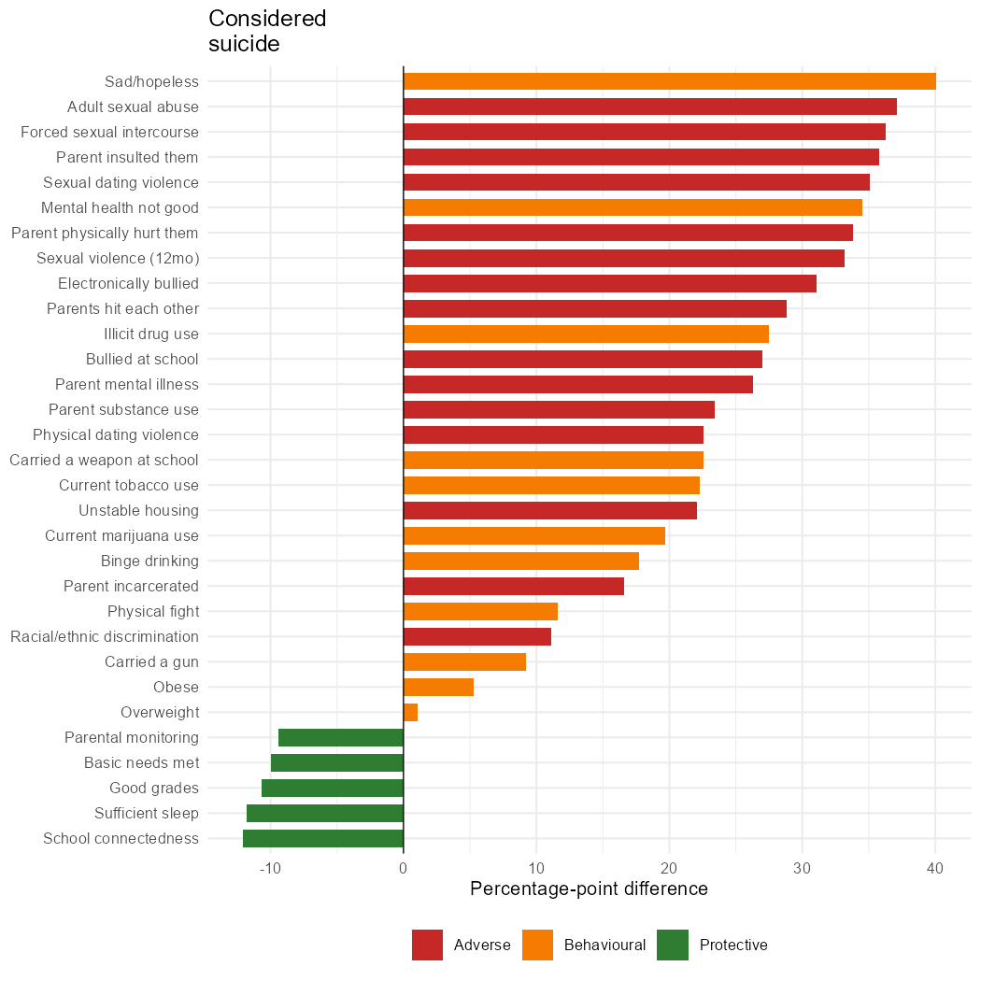
Cooccurrence
Sad/Hopelessness
Adult Sexual Abuse
Forced Sexual Intercourse
School connectedness
Sleep
Basics Needs Met

Slide 23
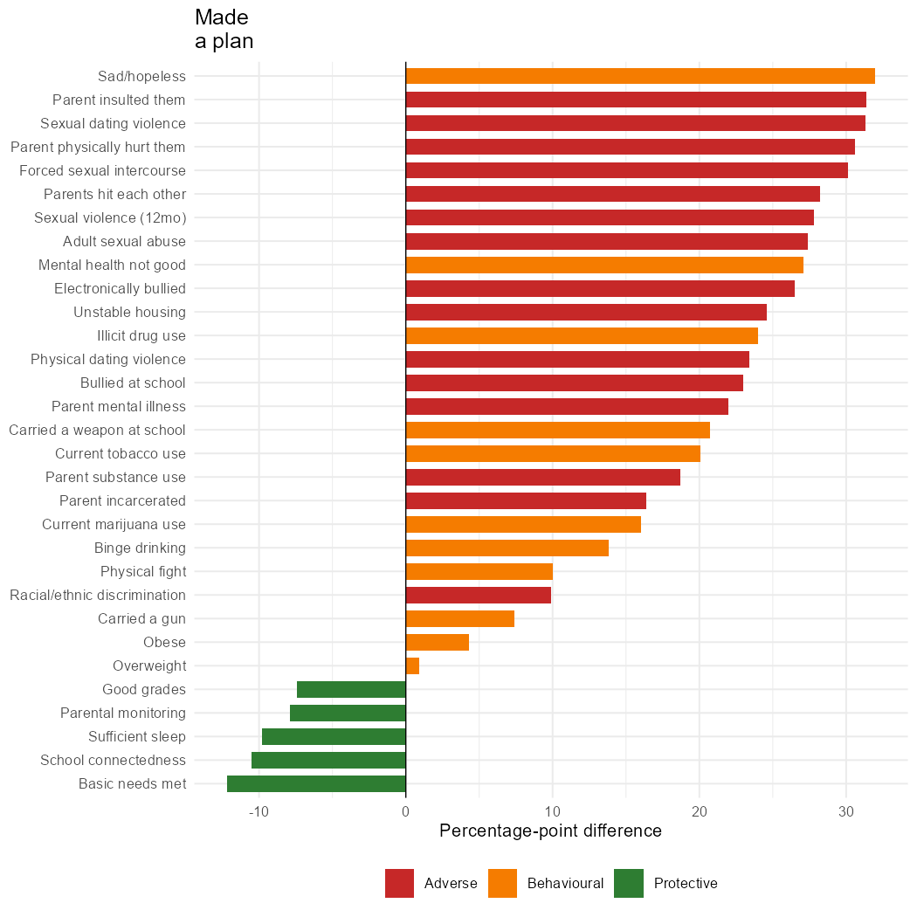
Cooccurrence
Sad/Hopelessness
Parents Insulted Them
Sexual Dating Violence
Basic Needs Met
School Connectedness
Sufficient Sleep

Slide 24
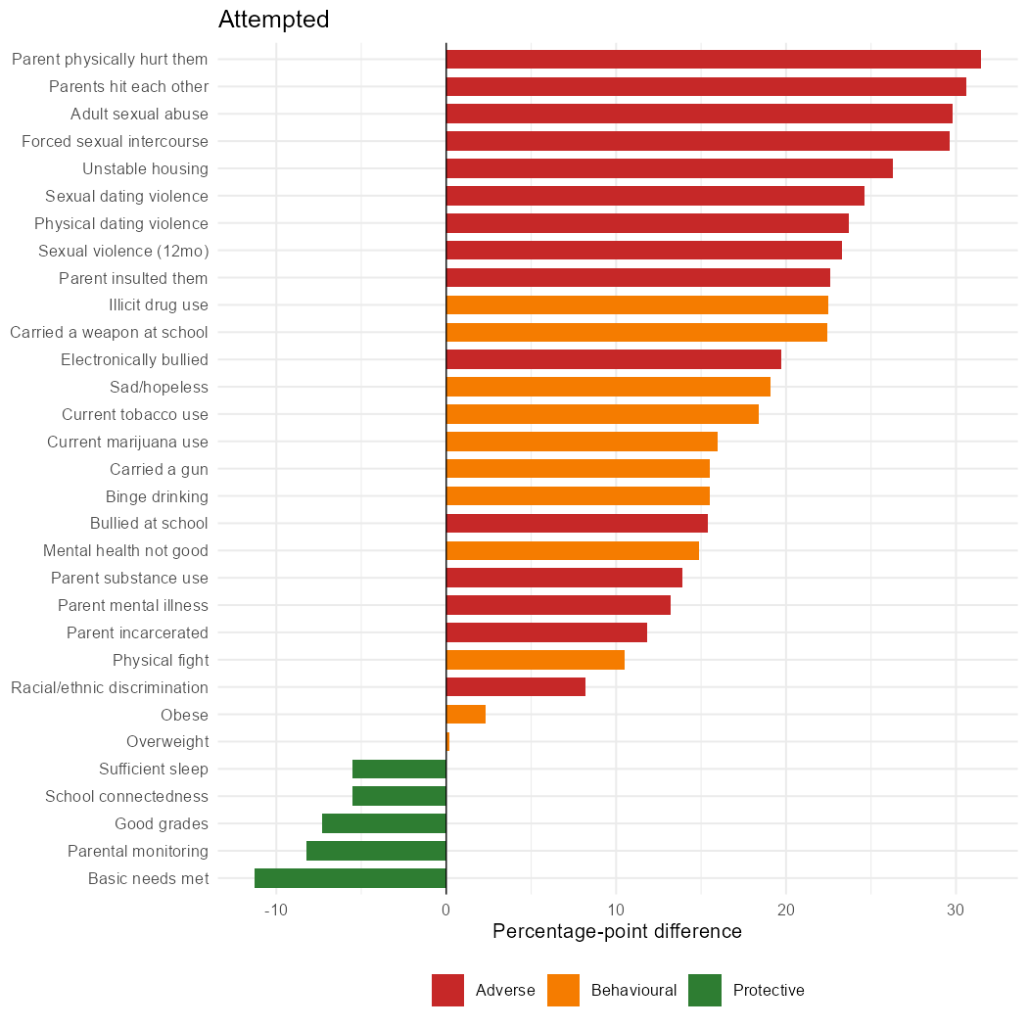
Cooccurrence
Parent’s physically hurt them
Parents hitting each other
Adult Sexual Abuse
Basic Needs Met
Parental monitoring
Good Grades

Slide 25
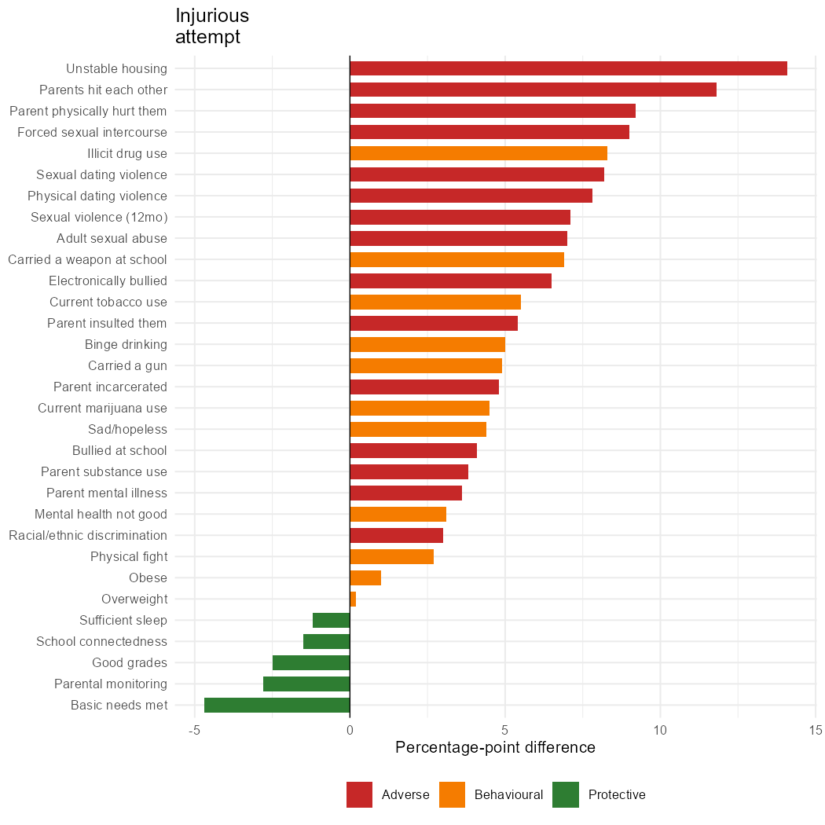
Cooccurrence
Unstable Housing
Parent’s hitting each other
Forced Sexual Intercourse
Basic Needs Met
Parental Monitoring
Good Grades

Slide 26
04
Limitations
A closer look at our dataset refinements and further analysis

Slide 27
Limitations
Cross-Sectional, Self-Reported Data
Findings indicate co-occurrence, not causation or prevention.
Missing Data
Per-comparison exclusion was not tested against alternative approaches, so the sensitivity of findings to missing-data assumptions is unknown.
Variable Coverage
Sexual orientation and gender identity were outside the scope of the analysis, while the null association for weight status may reflect the absence of measures capturing perceived weight and weight-based teasing.
Unmeasured Confounders
Household socioeconomic status is known to shape both protective factors and mental health outcomes; however, it isn’t captured in the YRBS.

Slide 28
Limitations cont’d
Demographic Subgroup Uncertainty
American Indian/Alaskan Native, Native Hawaiian/Pacific Islander, and the youngest age/lowest grade groups had wider confidence intervals, reflecting smaller sample sizes.
Recall & reference periods
Different questions ask about “during your life,” “past 12 months,” and “past 30 days”.
These inconsistent windows can affect recall and comparability.
Overlapping factors
Protective factors are interrelated (i.e., a well-monitored student may also sleep more), so this analysis can't isolate each factor's independent contribution.

Slide 29
05
Conclusions
A summary of our future direction and next research question

Slide 30
Two sides of the same picture
Adverse experiences
Protective factors
Risk shifts with the severity of outcomes, not one factor throughout
Distress and sexual violence lead ideation and planning outcomes
Household violence and unstable housing take over at attempt and injury
Protective factors are common in the population, not rare
Their absence, not their scarcity, tracks with worse outcomes
Basic needs met is the most consistent factor across the whole pathway
The largest adverse effect always outweighs the largest protective one, and the gap narrows for the more severe outcomes.

Slide 31
Future Directions
Robustness testing
Re-estimate key findings under alternative missing-data assumptions, such as complete-case analysis
Multivariable modelling
Adjust for demographic and other potential confounders, consistent with the CDC's companion analysis
Expanded equity analysis
Incorporate sexual and gender identity using the raw survey data and appropriate recoding

Slide 32
Next Research Question?
Do the strength of key co-occurrence associations, rather than only outcome prevalence, vary across sex and racial/ethnic groups?
For example, does the association between sadness/hopelessness and suicidal ideation remain consistent across demographic subgroups, or is it concentrated within populations?

Slide 33
THANK YOU!
Team 04 – “The Therapists”

